Slide 1
Smart Home Energy Management System Using IoT and Big Data Analytics Approach
S Hemanth
S7 D 53

Slide 2
Overview
Increasing cost and demand of energy has led many organizations to find smart ways for monitoring, controlling and saving energy.
A smart Energy Management System can contribute towards cutting the costs while meeting the energy demand with the help of emerging technologies like Internet of Things(IoT) and Big Data.

Slide 3
What is Smart Home?
A smart home is a residence that uses internet-connected devices to enable the remote monitoring and management of appliances and systems, such as lighting and heating.
Home automation also helps consumers improve efficiency. Instead of leaving the air conditioning on all day, a smart home system can learn your behaviors and make sure the house is cooled down by the time you arrive home from work.
With the help of a smart irrigation system, your lawn will only be watered when needed and with the exact amount of water necessary.

Slide 4
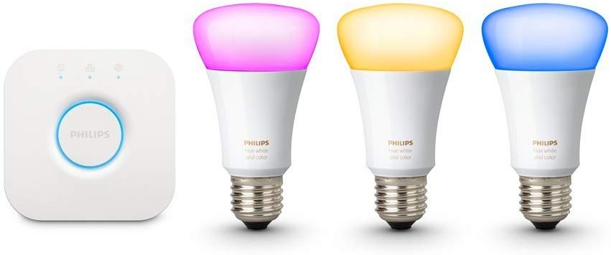
Information architecture
Smart Bulb

Slide 5
Home Energy Management System.
Each home device is interfaced with a data acquisition module to collects energy consumption data from each device & transmits the data to a centralized server for further processing and analysis.
The consumers,being aware of their consumption behavior and having a close interaction with the electricity utilities, can adjust and optimize their power consumption and reduce their electricity bills.
The use of IoT also enables seamless remote access control of home devices where the customers get online access to the ON/OFF usage pattern of in home appliances via a personal computer or a mobile phone.

Slide 6
Proposed System
The functions of the system are:
The Data acquisition module should gather power consumption information & the ambient condition information periodically, and send it to a centralized server.
The server should parse the information and transmit the readings to a central data storage system or database.
The stored data should be used by analytics engine to process it and generate reports, graphs, and charts.
Clients should be able to view the generated graphs through a cross-platform mobile application.

Slide 7
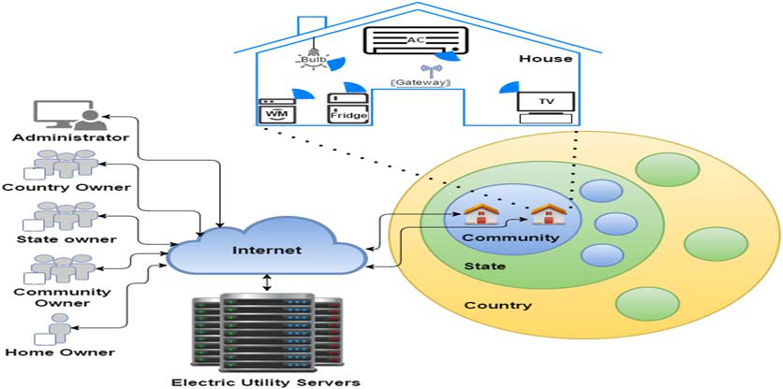
System Architecture.

Slide 8
01.
Hardware Architecture
Sensors and Actuators
Temperature and Humidity sensor
Solid State Relay
High-end Microcontroller
Raspberry-Pi
Zigbee Module
Servers
1

Slide 9
02
Software
Architecture
Data Acquisition Module
This module has two functions namely, monitoring function and controlling function.
Transmits the reading using MQTT protocol.
Transmitted data frame

Slide 10
02
Software
Architecture
MQTT Server
Consist of MQTT Broker and Client.
Analytics Engine server
Intelligence software tool was utilized to make smart decisions from the received Big Data.
The measured data is sorted and classified based on temperature, humidity and power consumption per house.
This classification is used to generate reports, graphs, and charts that identify the consumption pattern of the houses in a residential area.

Slide 11
03
Client Application Module
The mobile user interface for the clients.
It displays the generated graphs, charts, and reports to end users.
Monitoring power consumption data of each house device
Remote control services (ON/OFF) for house devices

Slide 12
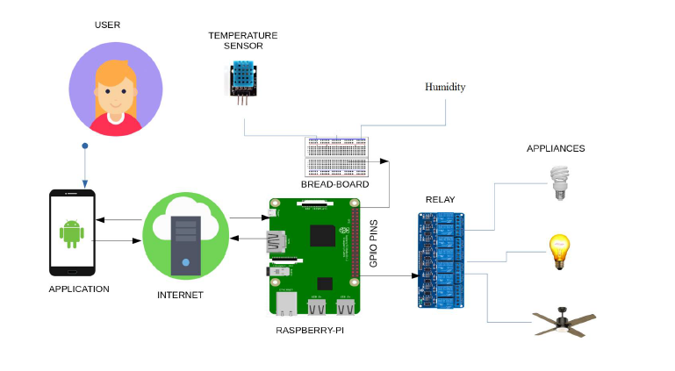
Implementation

Slide 13
Conclusion.
The proposed work is set to open new avenues for smart energy management on IoT and Big Data platform.
The system empowers users to remotely monitor and control the devices.

Slide 14
References
“Design and implementation of building energy monitoring and management system based on wireless sensor networks,” 2015 Tenth International Conference on Computer Engineering & Systems (ICCES), Cairo, 2015, pp. 230-233.
J. Han, C. s. Choi, W. k. Park, I. Lee and S. h. Kim, “Smart home energy management system including renewable energy based on ZigBee and PLC,” IEEE Trans. Consumer Electron, vol. 60, no. 2, pp. 198-202, May 2014.
Y. T. Lee, W. H. Hsiao, C. M. Huang and S. C. T. Chou, “An integrated cloud-based smart home management system with community hierarchy,” IEEE Trans. Consumer Electron, vol. 62, no. 1, pp. 1-9, Feb. 2016.

Slide 15
Thank You !!

